Slide 1
Presence of cognitive impairment in emergency general surgery
J Law, L Pearce, E Norris, J Hill
Manchester Regional Association of Surgeons
Stepping Hill Hospital – 7 Nov 2014
Notes:
Have a look at opsoc.eu
Presentation on prev data
Have a word about opsoc - multiple projects on surgery in older surgical patients

Slide 2
Background
Increasing in older patients in both acute an elective surgery
Rate of surgical procedures in older people is increasing faster than the rate of ageing
Extra consideration of this population is relatively new to surgery
Surgery in the older population carries other considerations
Partridge, J.S., et al. Frailty in the older surgical patient: a review. Age and ageing (2012)

Slide 3
Cognitive impairment
COMMON
  25% hospital beds occupied by patients with dementia
  1 in 3 people over 65 will go on to develop dementia
  Set to double over the next 30 years
PRE-OPERATIVE STRATIFICATION (Emerging evidence)
  Increased incidence of 1 or more post-op complication
  Increased 6 month mortality
  Increased LOS
2012 CQUIN:
  Financial rewards for hospitals offering dementia and delirium risk assessments
  90% older patients (over 3 consecutive months)
Department of Health, CQUIN: Prime Minister's Challenge on Dementia (2012)
Robinson, T.M. et al. Pre operative cognitive dysfunction is related to adverse post- operative outcomes in the elderly. J Am Coll Surg (2012)
Notes:
BEFORE THIS FIRST SLIDE – NEW SLIDE WITH A FEW WORDS – talk around
Increasing ageing population, difficult decision of when to operate and not
Increasingly age is not sufficient a reason not to operate
Looking at risk stratification being more common for surgical patients - ?further additions to this
Risks of operation/outcomes/LOS
We thought previously that dementia in acute surgical patients isnt assessed
Effects of cognitive impairment on pre op – consent, assessment/ post-op – ERAS difficulties reaching milestones, increased LOS, likelihood to require further care
Increasing help for older patients with multiple medical problems/cognitive impairment makes a massive difference – e.g orthogeris in NOF patients improves outcomes
RISK STRATIFICATION
In current risk stratification we look at end organ function – PPOSSUM
Should we be looking at more?
Increased incidence of post op complications even when adjusted for age, ASA grade and risk factors
CQUIN standard - include %
Along the bottom of paper refs
1st author et al. Title and journal

Slide 4
Frailty
"A medical syndrome with multiple causes and contributors that is characterised by diminished strength, endurance, and reduced physiologic function that increases an individual's vulnerability for developing increased dependency and/or death"
Increased risk of mortality after hospital admission:
  Within 30 days of admission (OR 4.04, CI 95% 1.07 – 15.21)
  Within 90 days of admission (OR 3.04, CI 95% 1.25 – 7.43)
Increased LOS
As likely to undergo surgery as non-frail patients
Department of Health, CQUIN: Prime Minister's Challenge on Dementia (2012)
Hewitt J., et.al Prevalence of Frailty and its Association with Mortality in General Surgery. Am J Surg (2014)

Slide 5
Aim
To assess older acute surgical patients for cognitive impairment and delirium
To assess older acute surgical patients for frailty and baseline markers (such as Hb, Albumin)
Outcome data for mortality, CT scanning and surgical procedures
Contribute to a larger pool of data for a National audit regarding older surgical patients
Notes:
Audit but starting from nothing – as no patients have AMT
Data will contribute national audit
None of our patients were assessed – AMT in booklet, not filled in
Would aim to report this at the end of our audit, and compare AMT with MOCA

Slide 6
Method
Single institution
Patients over 65 years old admitted to acute general surgery
One month
Baseline data (including age, Hb, albumin, co-morbidities, polypharmacy)
Montreal Cognitive Assessment
Confusion Assessment Method
Canadian Study of Health and Ageing frailty scale
Outcome data – CT/Surgical procedures, 30 day mortality, 30 day readmission to hospital
Statistical analysis using SPSS version 20 – Chi Squared test
Notes:
City centre – urban population
Write full titles in tools – don’t need to include what they are for

Slide 7
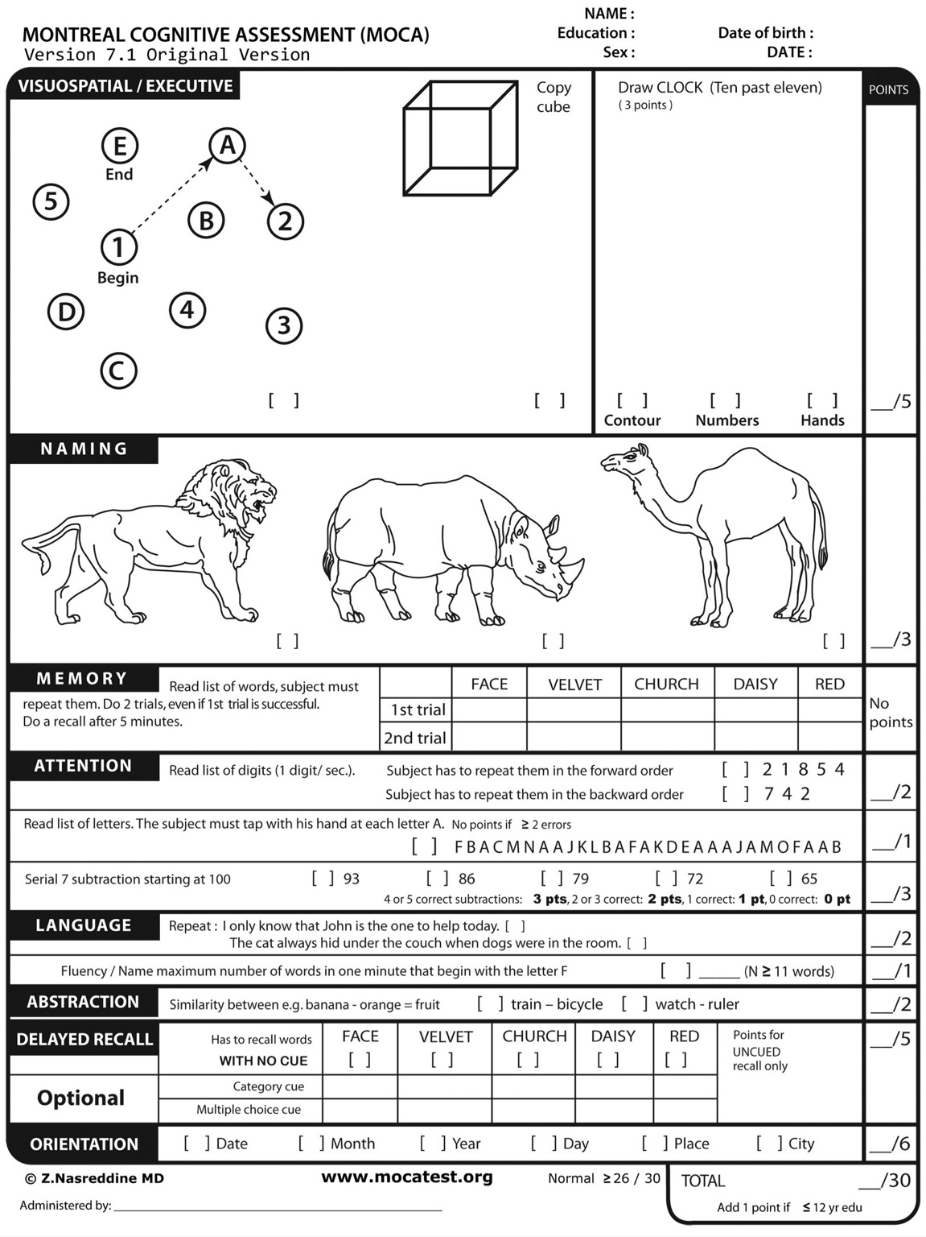
MoCA
Validated for use for assessing cognitive impairment
More sensitive than mini-mental state examination (MMSE) at detecting mild cognitive impairment
Both MOCA and MMSE high specificity
Nasreddine. Z, et al. The Montreal Cognitive Assessment MoCA: A brief screening tool for mild cognitive impairment. J Am Geri Soc (2005)
Notes:
Need to contain what an abnormal score is

Slide 8
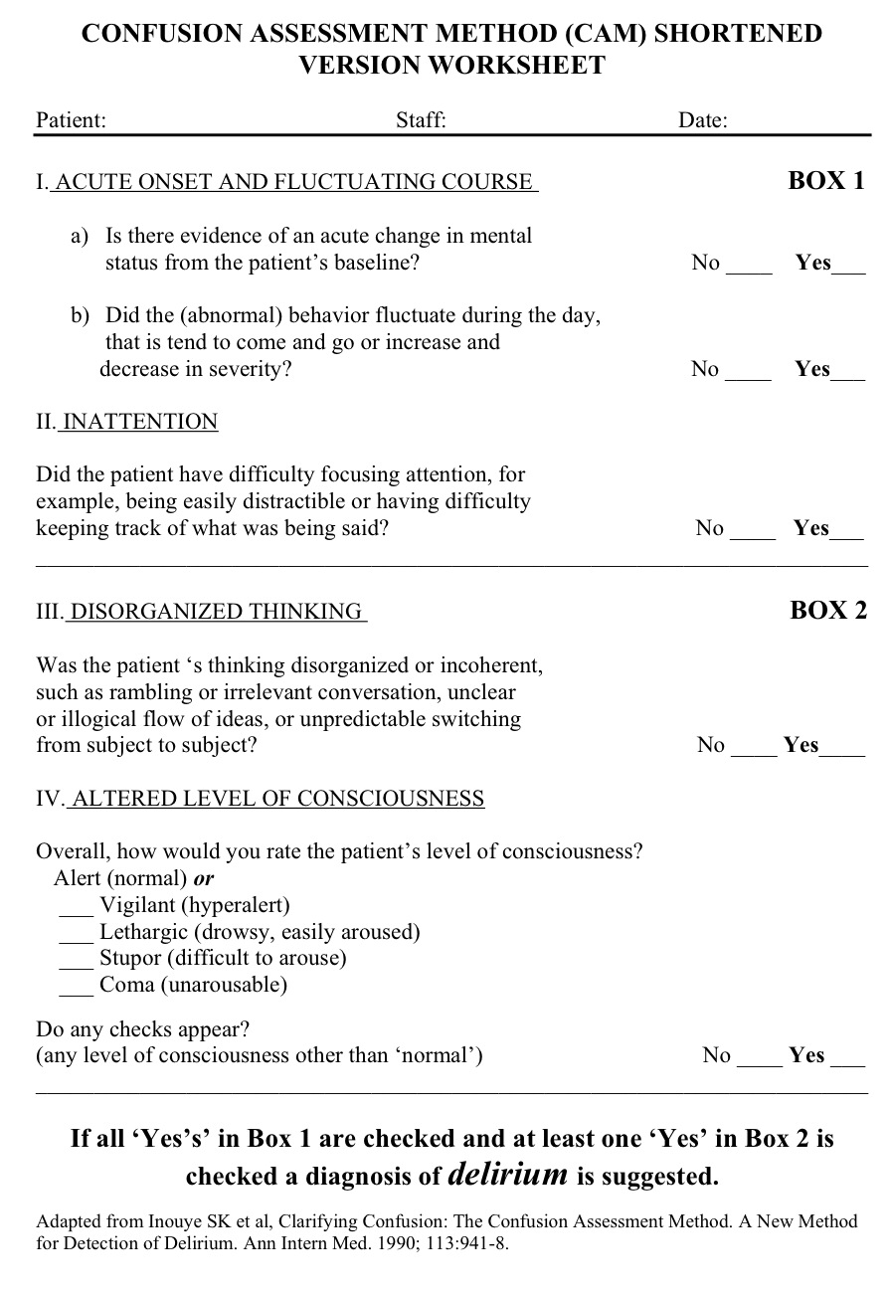
CAM
To assess for delirium
High sensitivity (94%) and specificity (89%)
Easy to use
Wei, L.A. et al. The Cognitive Assessment Method: A Systematic Review of Current Usage. J Am Geri Soc (2008)
Notes:
Need to add whats abnormal

Slide 9
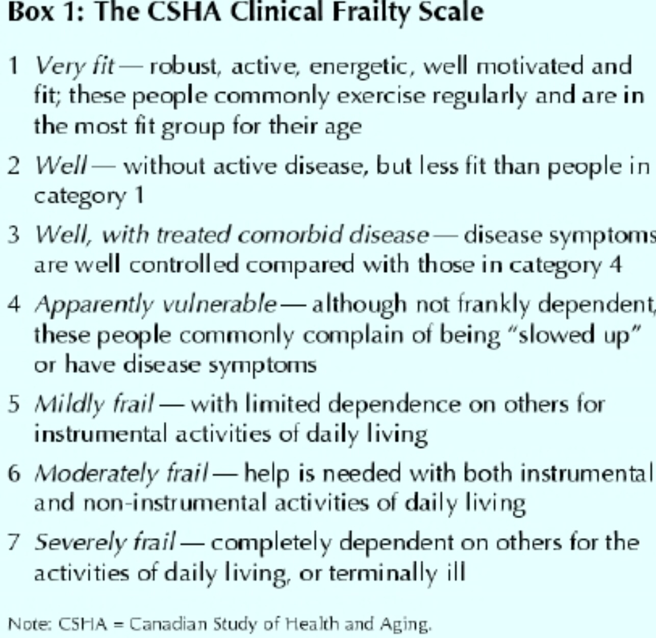
CSHA Frailty scale
Easy to use
No agreed single score for frailty
Rockwood K, et al. A comparison of 2 approaches of measuring frailty in elderly people. J Gerointol A Biol Sci (2007)
Notes:
The reason we use these 3 scores is that they correlate well with each other

Slide 10
Results
Total 50 patients:
  Mean age 75.19 yo (SD 7.58)
  27 (54%) Female
Mortality: single patient
  30 Day Mortality = 90 Day Mortality
Readmission at 30 days:
  22% patients readmitted
  8.3% readmitted if had a surgical procedure
Notes:
Pick out main points – plus those in the abstract

Slide 11
CT Scanning & Surgical Intervention

Slide 12
MOCA
  Mean 19.79
  Median 21 (range 0-29)
  13 (26%) in normal range
  2 (4%) unable to attempt as too unwell
  Correlation of abnormal MoCA:
    Multimorbidity (p <0.01)
    Age (p = 0.34)
    Sex (p = 0.162)

Slide 13
Frailty (CHSA score)
  18 (36%) assessed as vulnerable or frail
  Multimorbidity did not correlate
  with frailty (p = 0.39)

Slide 14
Conclusion
Abnormal MoCA (cognitive impairment) and multimorbidity correlate
Increased readmission rates with older patients who did not have surgical procedures
Older patients increasingly part of acute surgical admissions
Limitations: small sample size, emergency admissions only, other considerations
Contributing to National data
Notes:
But contributing to national data – data on frailty, Cog im, delirium
If now aim is specialist centres - they need to be able to have care packages in place for dealing with such patients – larger % populations, more readmissions

Slide 15
Thank you
www.opsoc.eu

